Slide 1

Single vs Dual Spur Gear for Handwheel Position Sensor
09AP14

Slide 2
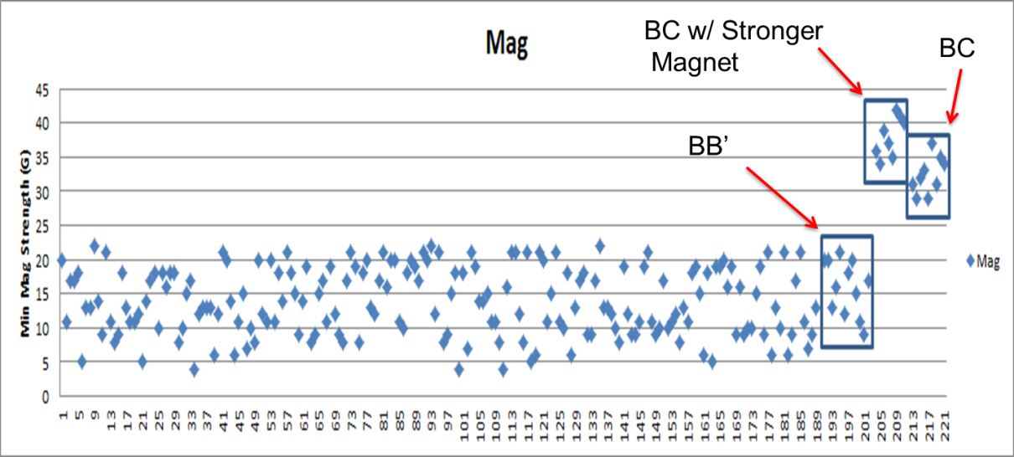
SGMW 200 Digital Position Sensor
Enhancements for Next Build (Week of April 14)
Allegro BC Chip – Significant Enhancement (Refer below)
Software update (dll & software release) …. Averaging
Probe Housing Shift of 1.0 mm (Location of Hall to Magnet)
Patent Search (2 Spur Gear) ---- Completed with no evident issues
In the chart below, the first ~190 points are from the sorting that was done in China (BB'). The first box are from the post DV testing (BB'). The second box is from the BC 1332s with the Max Baermann higher strength magnets (~50% increase) on the lower rotor assemblies. The third box is from the BC 1332s with the standard production lower rotor magnets.

Slide 3
C1XX Probe Housing Assembly Issue – Executive Summary
Problem Definition
Signal of the ring magnet in the probe housing assembly yields excessive error not suitable for the Nexteer manufacturing system (High FTQ)
Immediate Containment/Certification - IVER
Probe Housing 100% certified at component level
System level function test (Sensor Test, EOL)
Root Cause
Signal Strength of ring magnet not adequate half way between north and south poles
Past Improvement Development Activities
Evaluated hall sensor enhancements
Evaluated stronger ring magnets
4 pole magnets
2 levels of algorithm improvements
Multiple other concepts pursued
Robust Permanent Corrective Action
Replace the ring magnet function with a second spur gear which provides much improved accuracy
Layout change (No change to schematic)
Corresponding software algorithm
Verification
4 weeks - Mechanical Validation (See Slide # 7)
Electrical Validation (3172 Thermal Shock Testing for Probe Housing Asm – K2XX Profile)
EMC – Include in next round of EMC system testing

Slide 4
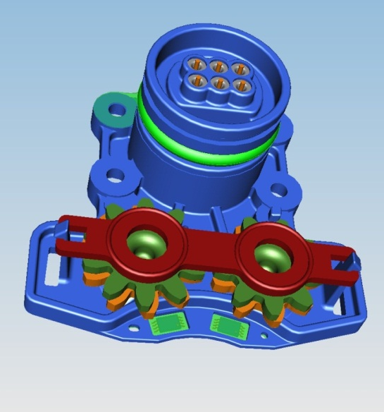
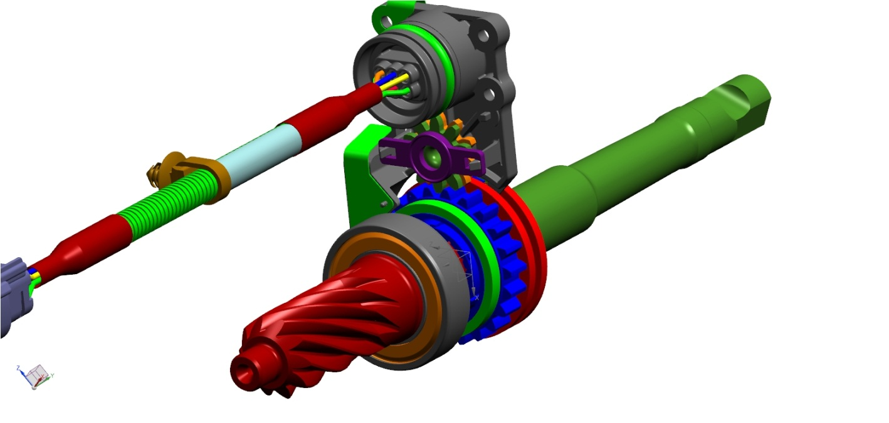
Dual Spur Gear
Single Spur Gear
Additional Spur Gear to be added
Lower rotor Magnet
to be removed
11 Tooth
10 Tooth
4

Slide 5
SENSOR – Position – Digital
Flux
Ring Magnet
In the digital system there is a single hall probe which is measuring the direction of the signal. The specified minimum magnitude of this signal is 100 G. With the ring magnet design, this signal strength was found to drop off significantly when the sensor is half way between the north and south poles. Weaker signal strength results in increased error.
Signal Strength concern
N
N
S
S

Slide 6
Digital Spur Gear Sensor
Each spur gear contains a single puck magnet. The hall probe is located directly above puck magnet. This provides a consistent magnetic magnitude of roughly 250 gauss, regardless of magnet position.
Hall Probe
Magnet
N
S

Slide 7
Dual Spur Gear Timing / Validation
C1xx design: complete
Initial Samples: 20JN14
Mechanical Validation: (4 weeks)
4 parts on component level test (pinion shafts and probe housing asm)
2 parts rotated to represent bottoming cycles
2 parts rotated to represent target life cycles
2 parts on random vibration
Cost request in process (47107)
Expectation is for small saving or same cost for Dual Spur design
Elimination of ring magnet: --
Addition of 2nd gear: ++
Modification to PH: 0
Modification to retainer: +
Modification to PCB: -

Slide 8
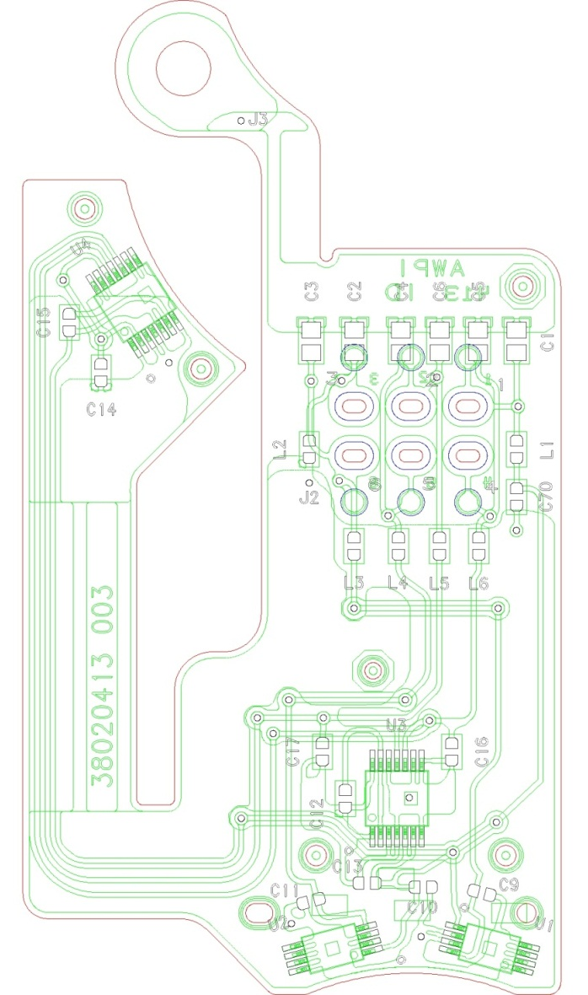
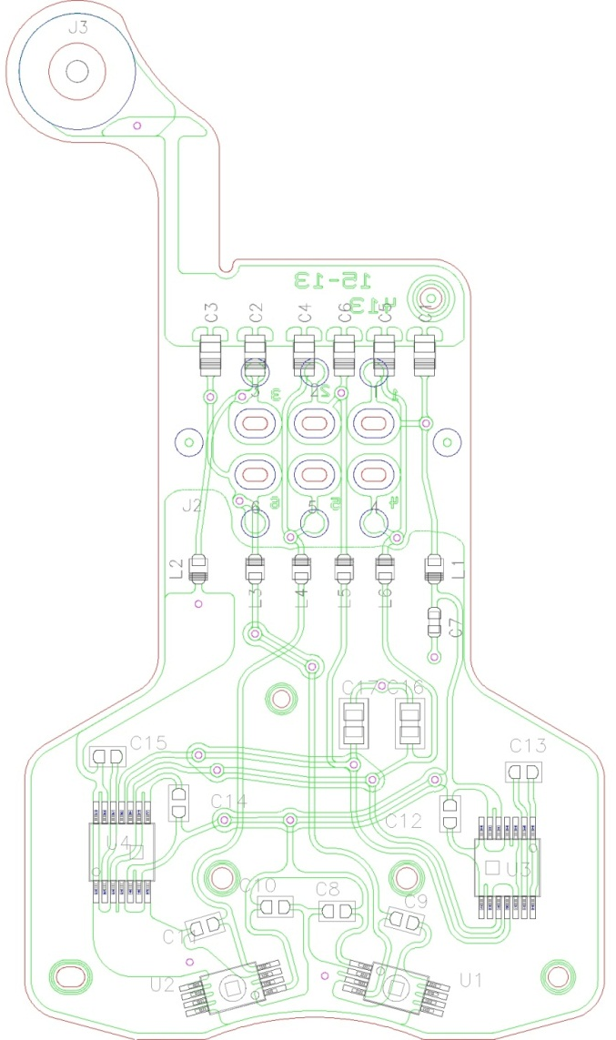
PCB layout change
Single Spur Gear
Dual Spur Gear

Slide 9
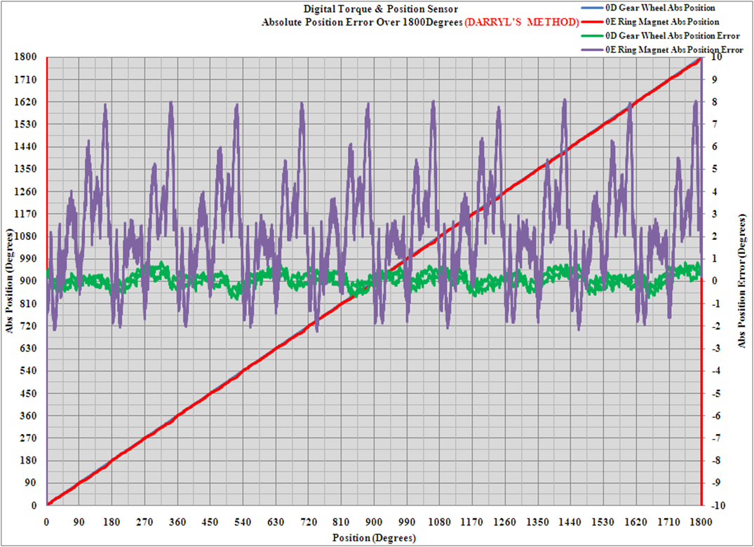
Ring Magnet vs Spur Gear Accuracy
The purple line below shows the typical error for a ring magnet sensor
The green line below shows the typical error for a spur gear sensor (puck magnet)

Slide 10
Position Algorithm Single Spur vs Dual gear
Step=ColSen-10Tooth/2.2
Step=10Tooth-11Tooth*11/10

